Slide 1
Python Examples
CYBR 493A

Slide 2
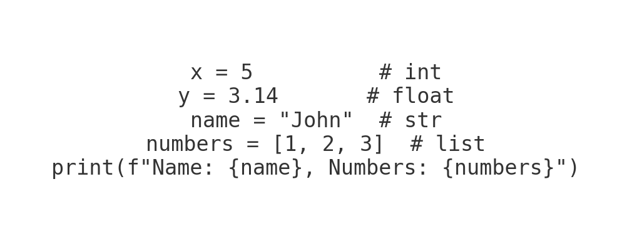
Variables and Data Types
Covers understanding Python's basic data types such as integers, strings, floats, lists, dictionaries, etc., and how to declare variables.

Slide 3
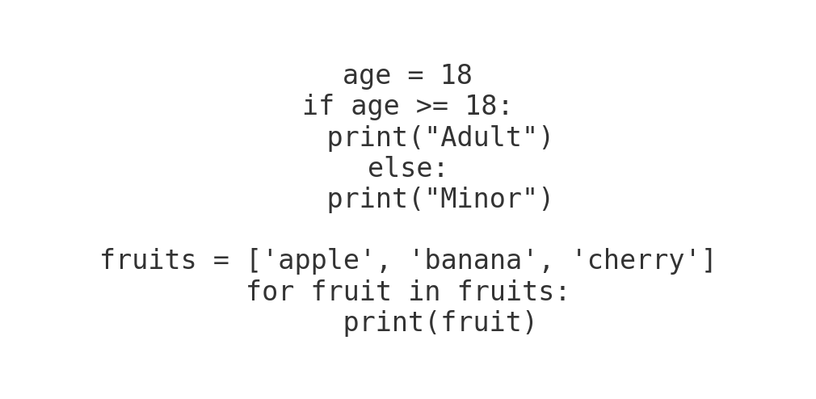
Control Structures
Control flow using 'if', 'else', 'elif', and loops ('for', 'while') to dictate program execution paths.

Slide 4
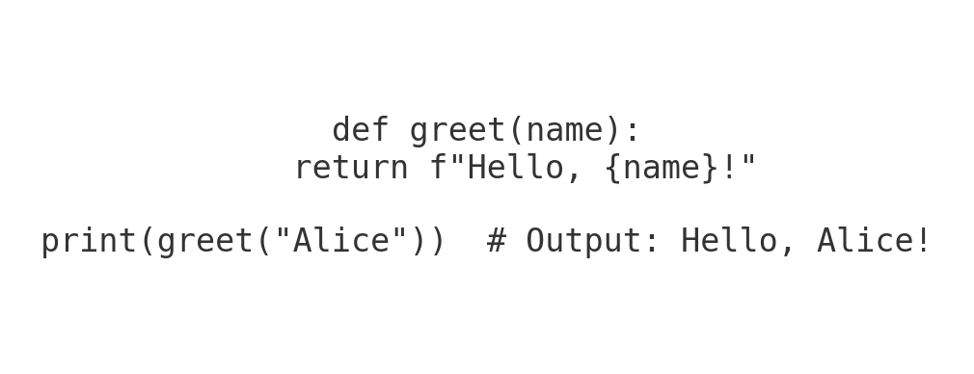
Functions
Creating reusable blocks of code using 'def' to define functions, with parameters and return values.

Slide 5
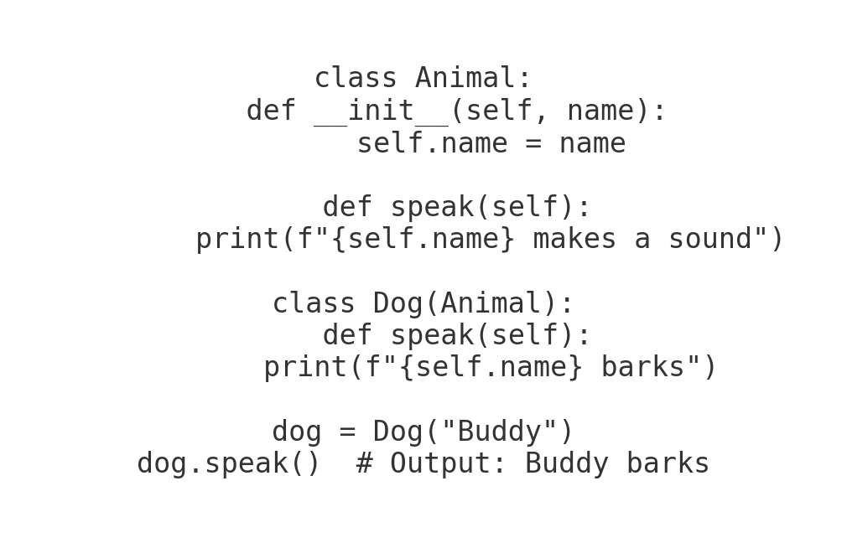
Object-Oriented Programming (OOP)
Explains Python classes, objects, inheritance, polymorphism, and encapsulation principles for structuring code.

Slide 6
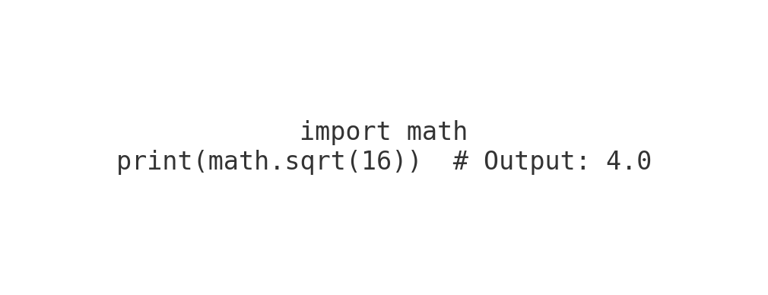
Modules and Packages
Demonstrates importing external libraries and building modular code with reusable components.

Slide 7
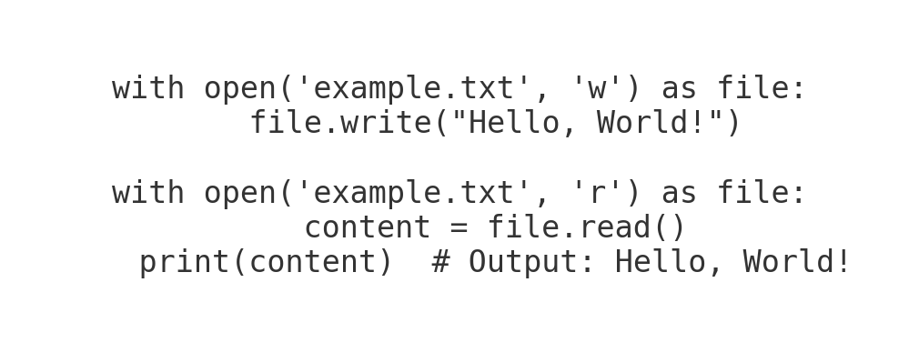
File I/O
Reading and writing files, including handling file formats like .txt, .csv, and .json, using Python.

Slide 8
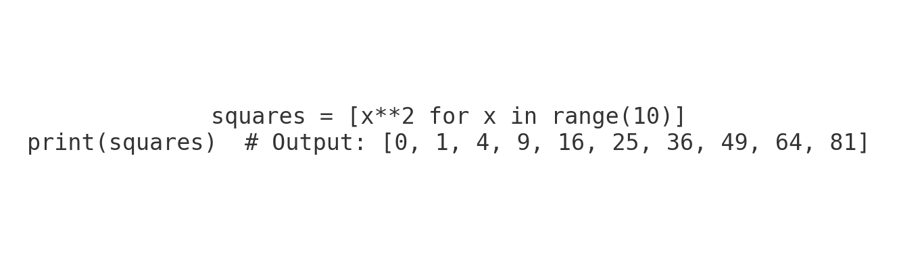
List Comprehensions
Short-hand way of creating lists, combining for-loops and conditionals within lists.

Slide 9
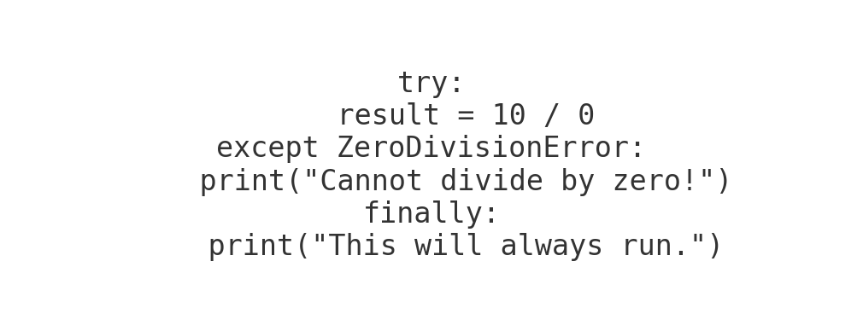
Error and Exception Handling
Using 'try', 'except', 'finally' blocks to catch and handle runtime errors and exceptions in Python.

Slide 10
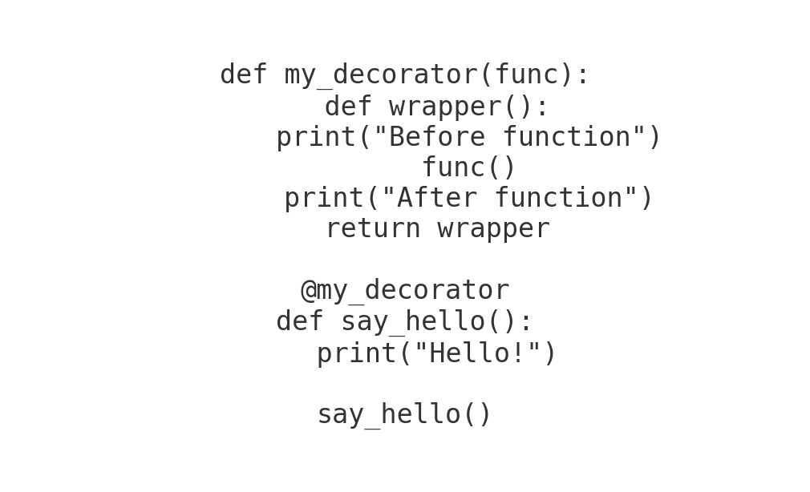
Decorators
Modifying functions or methods using decorators to add functionality without changing the original code.

Slide 11
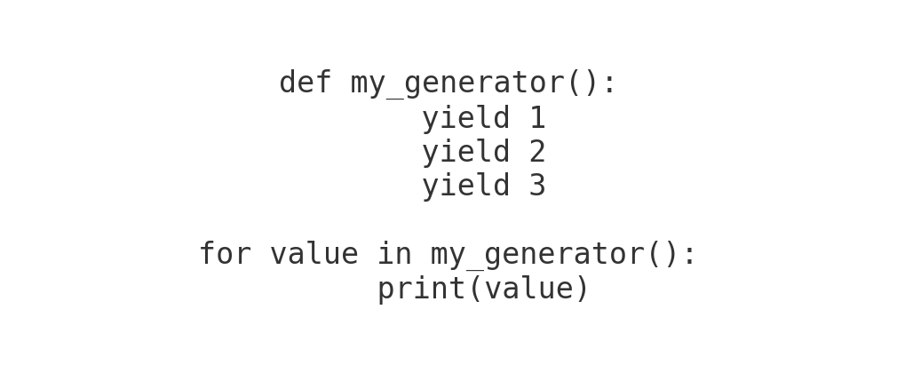
Generators and Iterators
Using generators to yield data one item at a time and iterators for looping over iterable objects in memory-efficient ways.

Slide 12
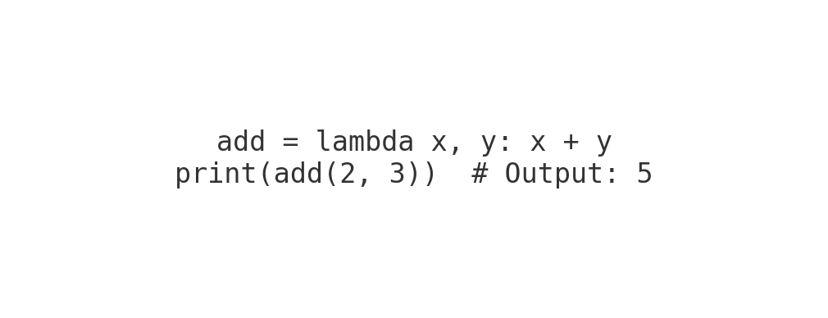
Lambda Functions
Using anonymous (lambda) functions for short-term, throwaway functionality.

Slide 13
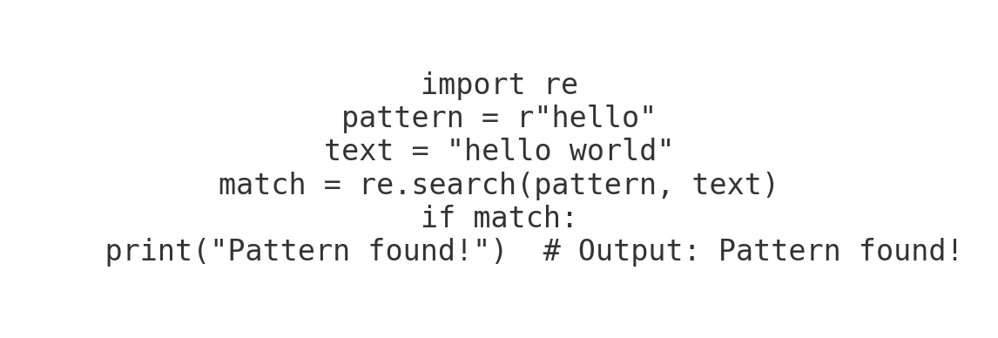
Regular Expressions
Handling strings with pattern matching, search, and text manipulation using Python's 're' module.

Slide 14
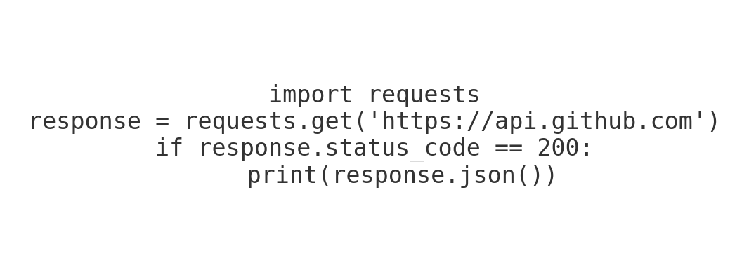
Working with APIs
Making HTTP requests using the 'requests' module to communicate with RESTful APIs and handle responses.

Slide 15
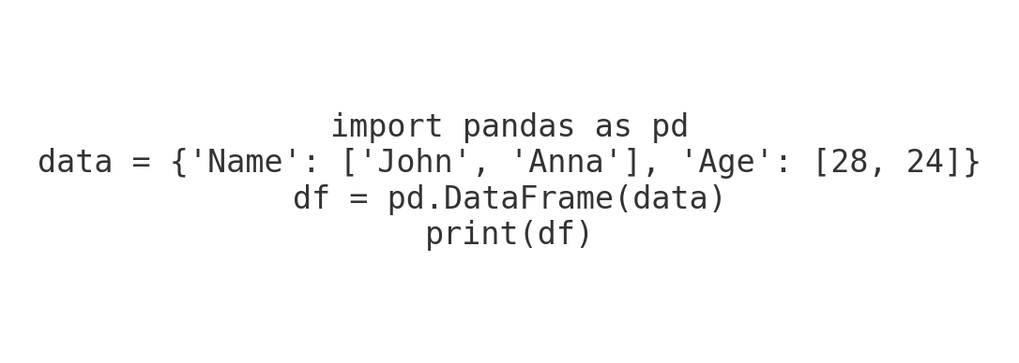
Data Science Libraries
Introduction to NumPy, Pandas, and Matplotlib for numerical computing, data manipulation, and visualization in Python.

Slide 16
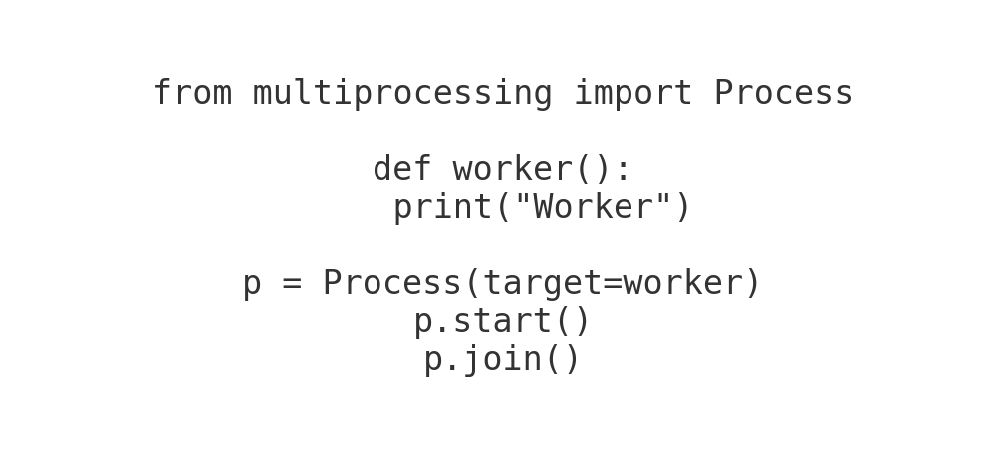
Multithreading and Multiprocessing
Implementing concurrency with threads (multithreading) and processes (multiprocessing) to parallelize tasks.

